Slide 1
DSD – Server Group
Mogic Group

Slide 2
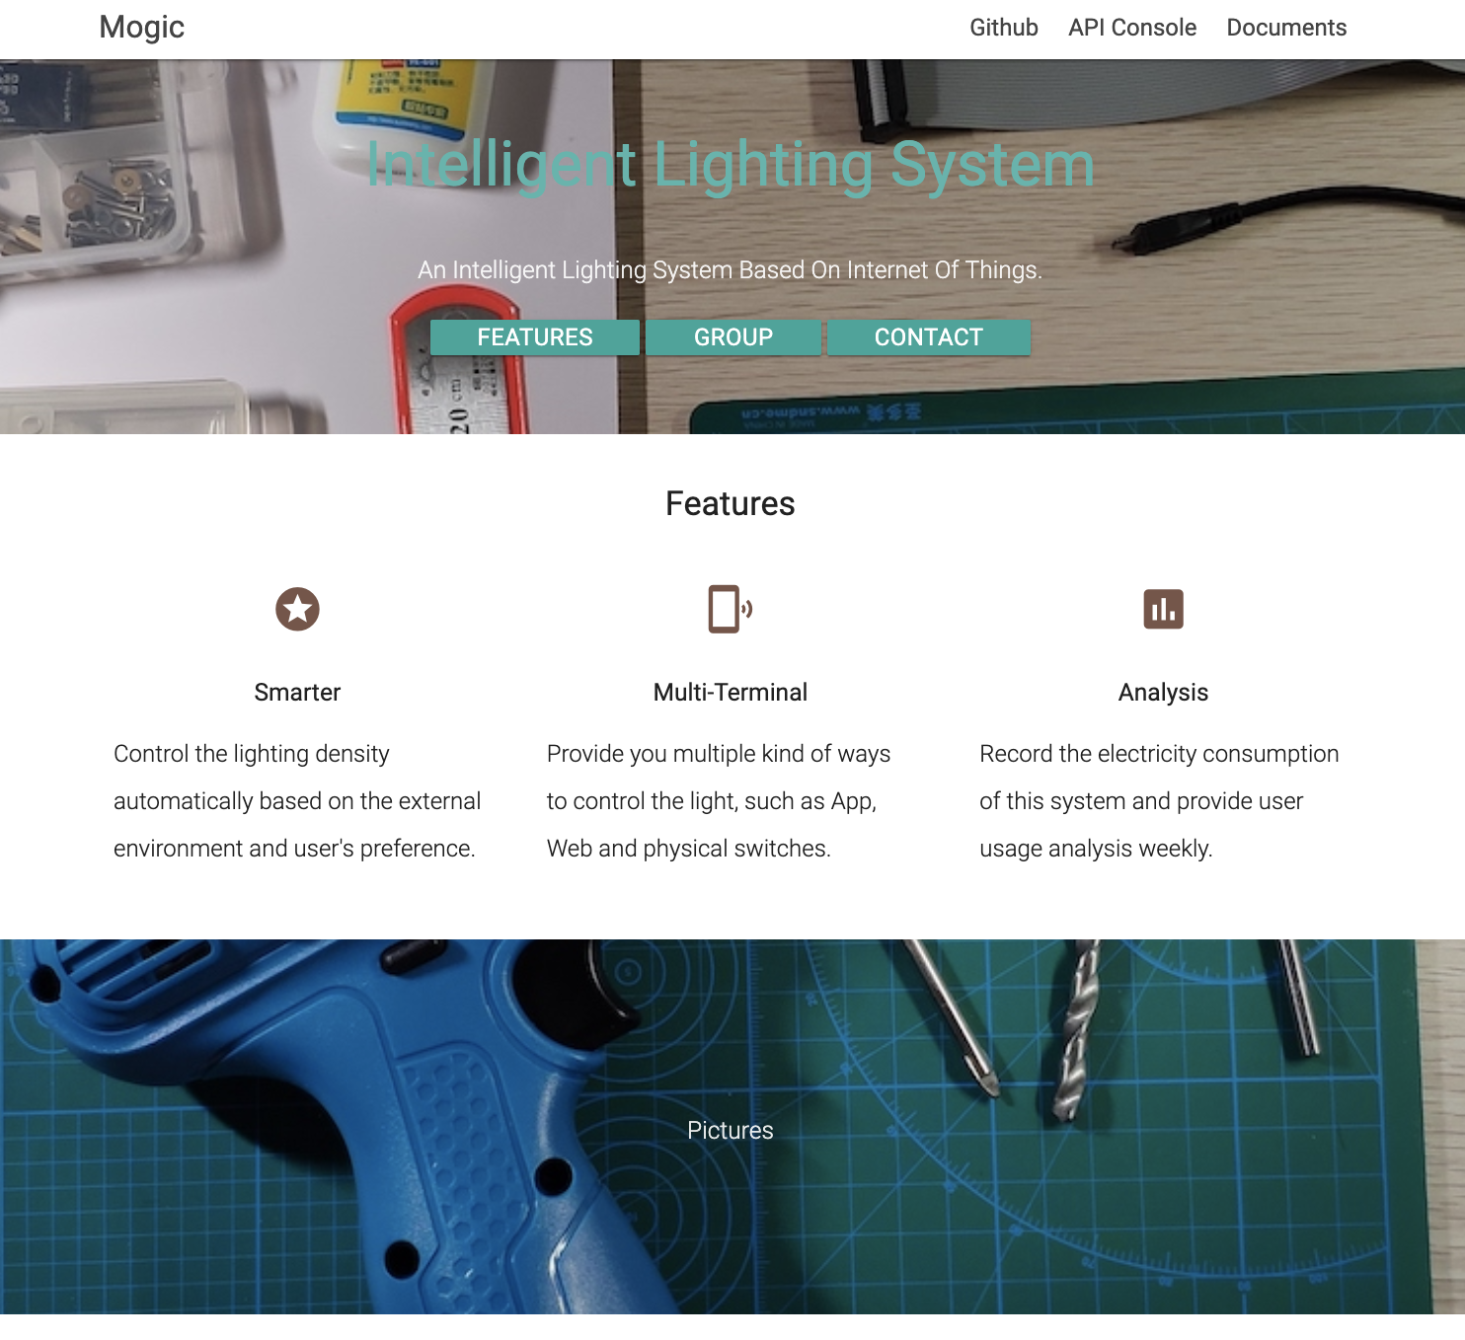

Slide 3
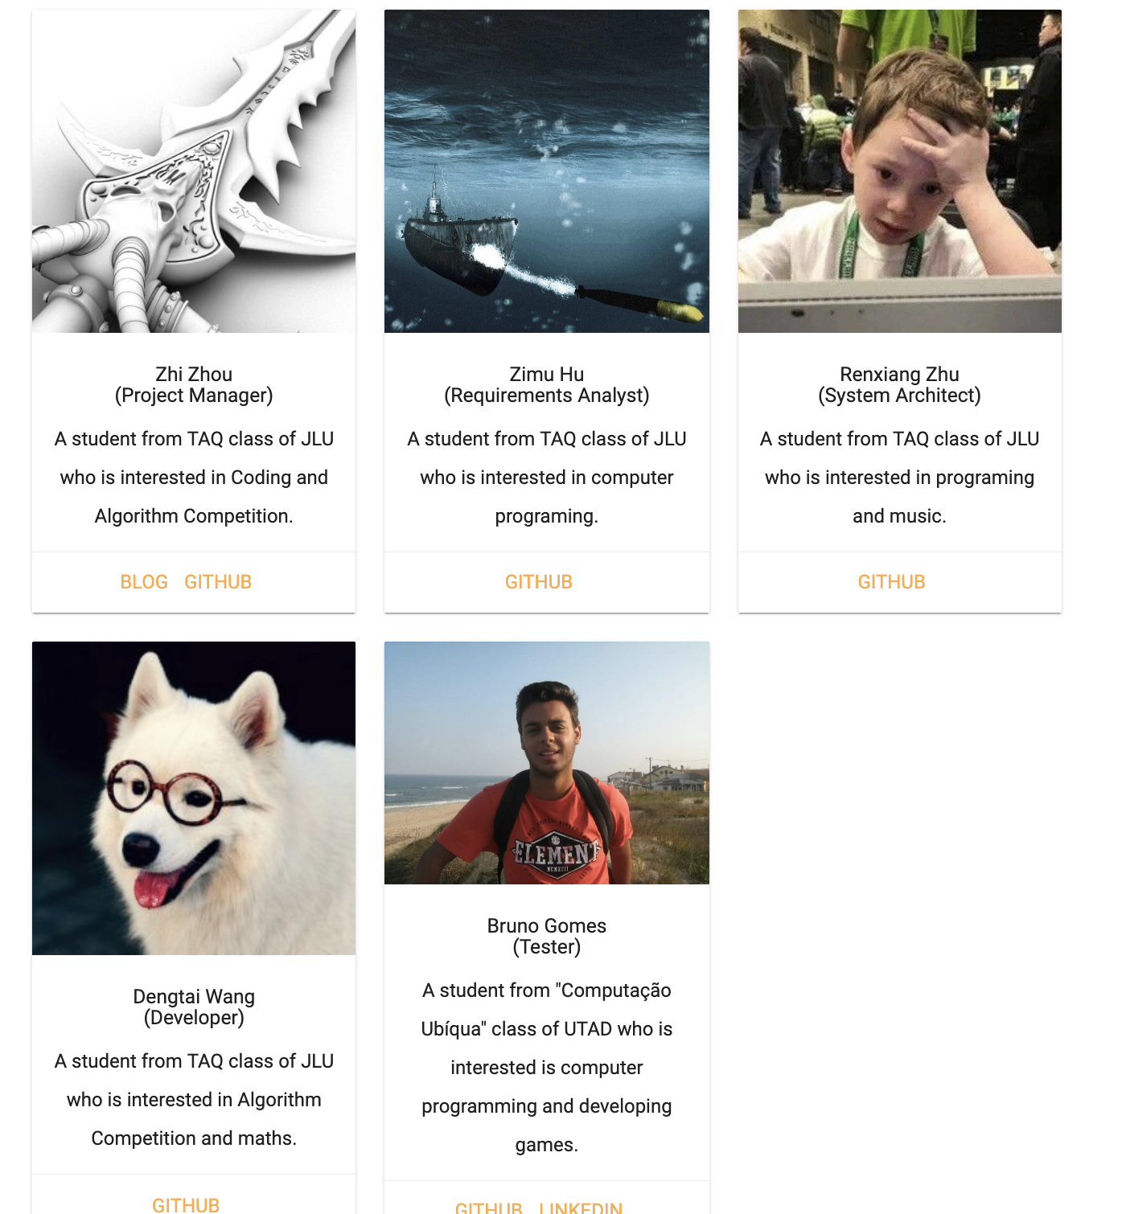
Group Members

Slide 4
Catalogue
Documents
GitHub & Code
Productions
Integration & Test
PART ONE
PART TWO
PART THREE
PART FOUR

Slide 5
Documents
PART ONE

Slide 6
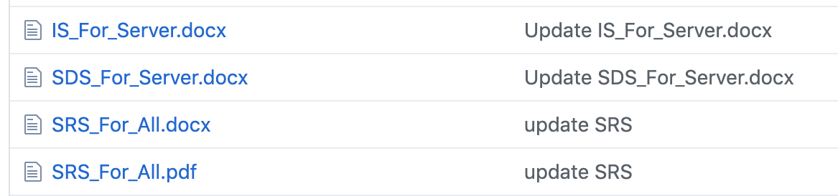
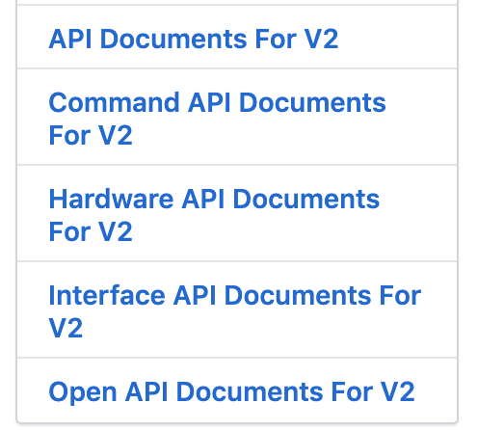
PART ONE Documents
1. SRS Documents For Server & All Groups
Write Requires of Server Part
Merge All Groups’ SRS Documents into a Final One – 13315 Words
2. IS Documents For Server
Interface Specification for Server Part -- 700 Words
3. SDS Documents For Server
System Design Specification for Server Part – 1300 Words
4. Interface Details On GitHub Wiki
Interface Details - 2 Versions

Slide 7
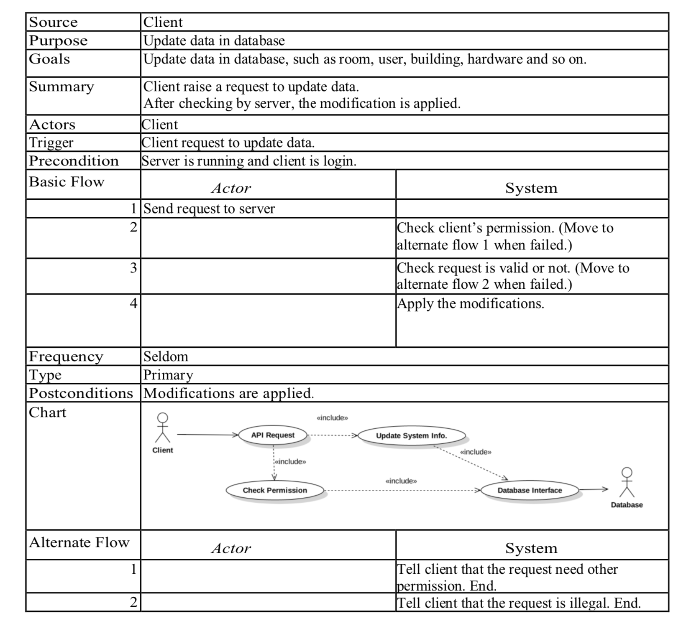
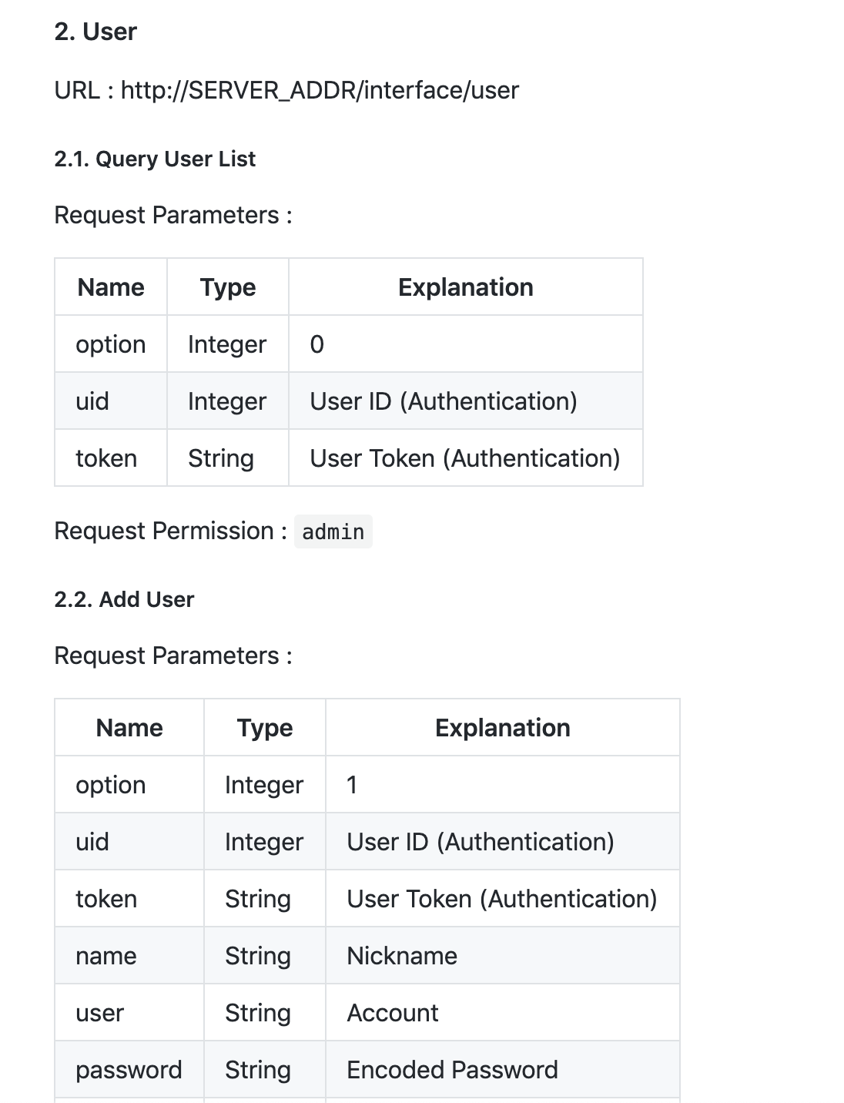
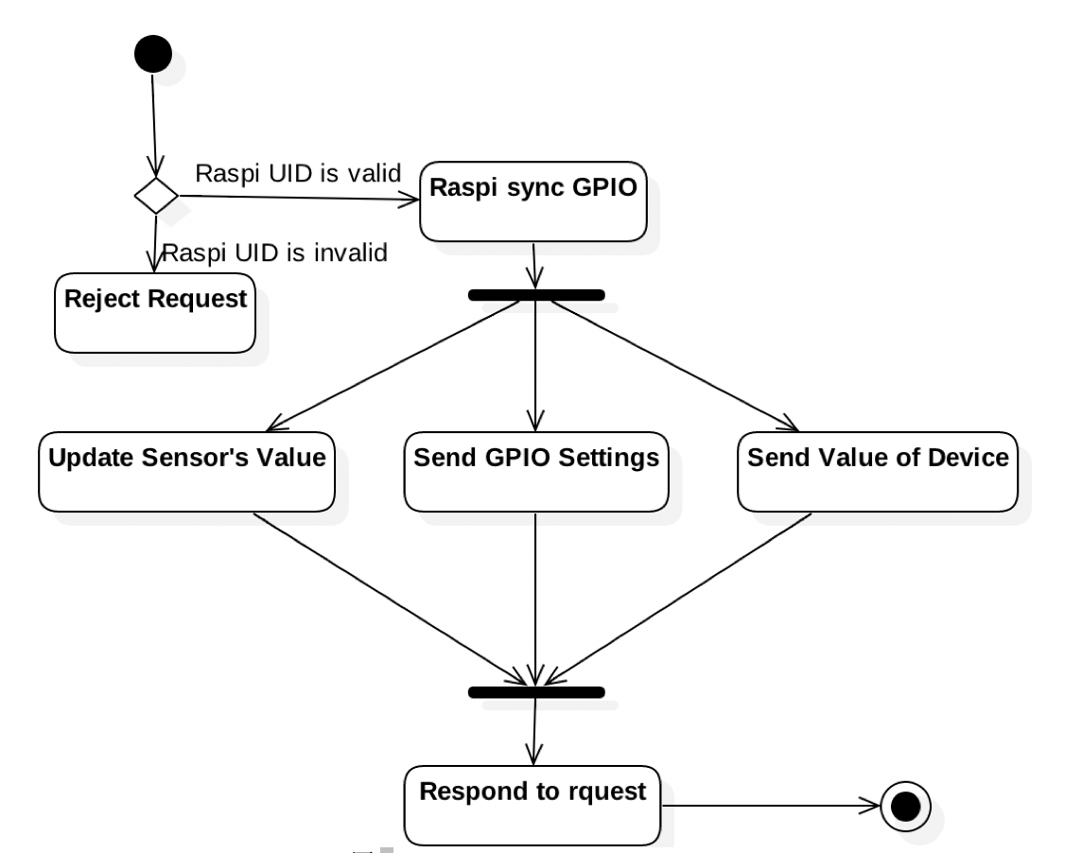
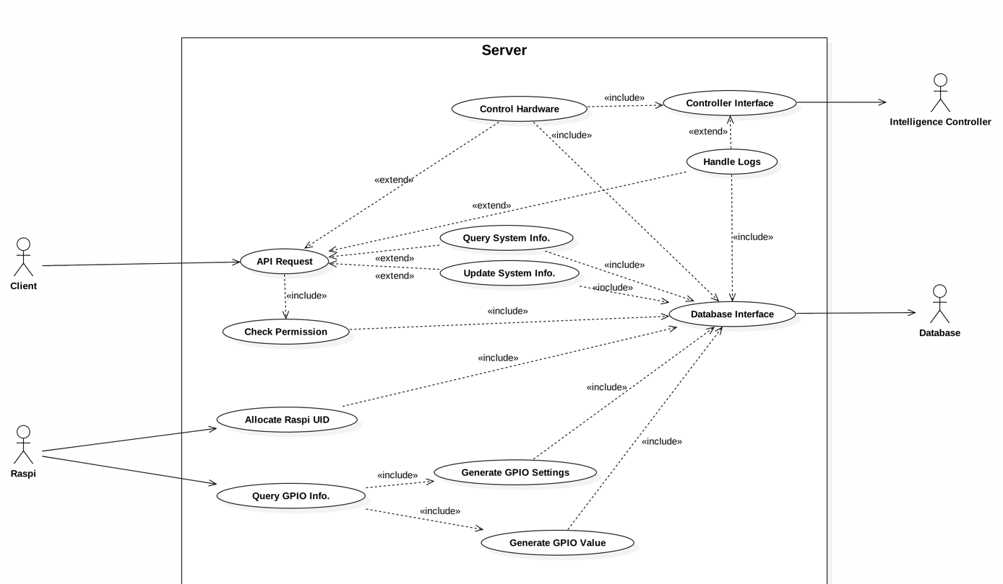
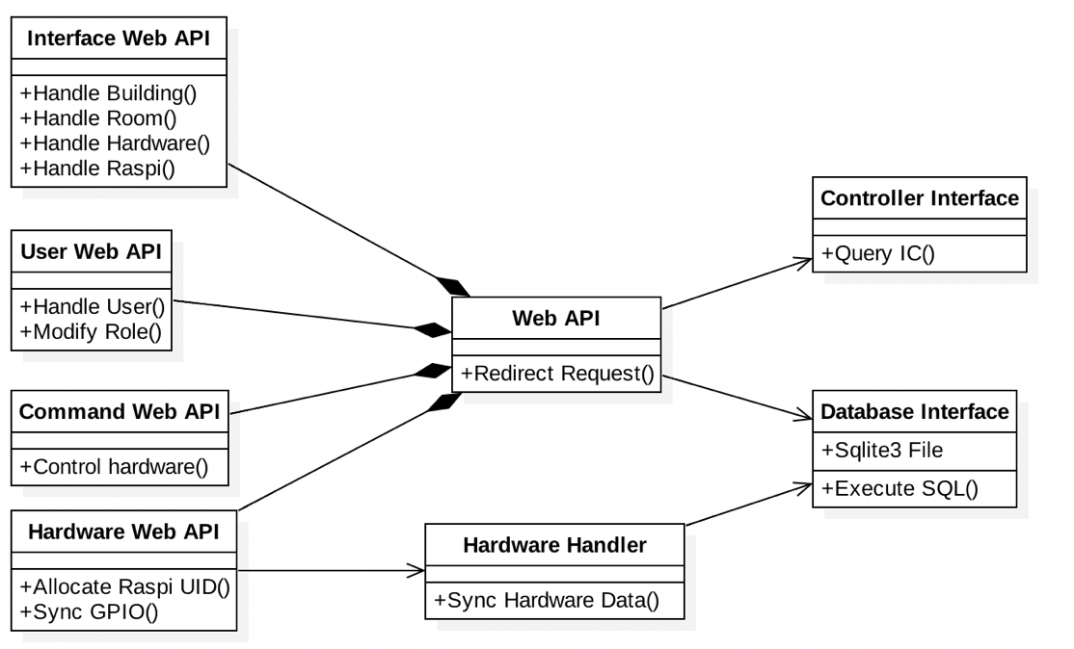
PART ONE Documents
Graphs & Tables

Slide 8
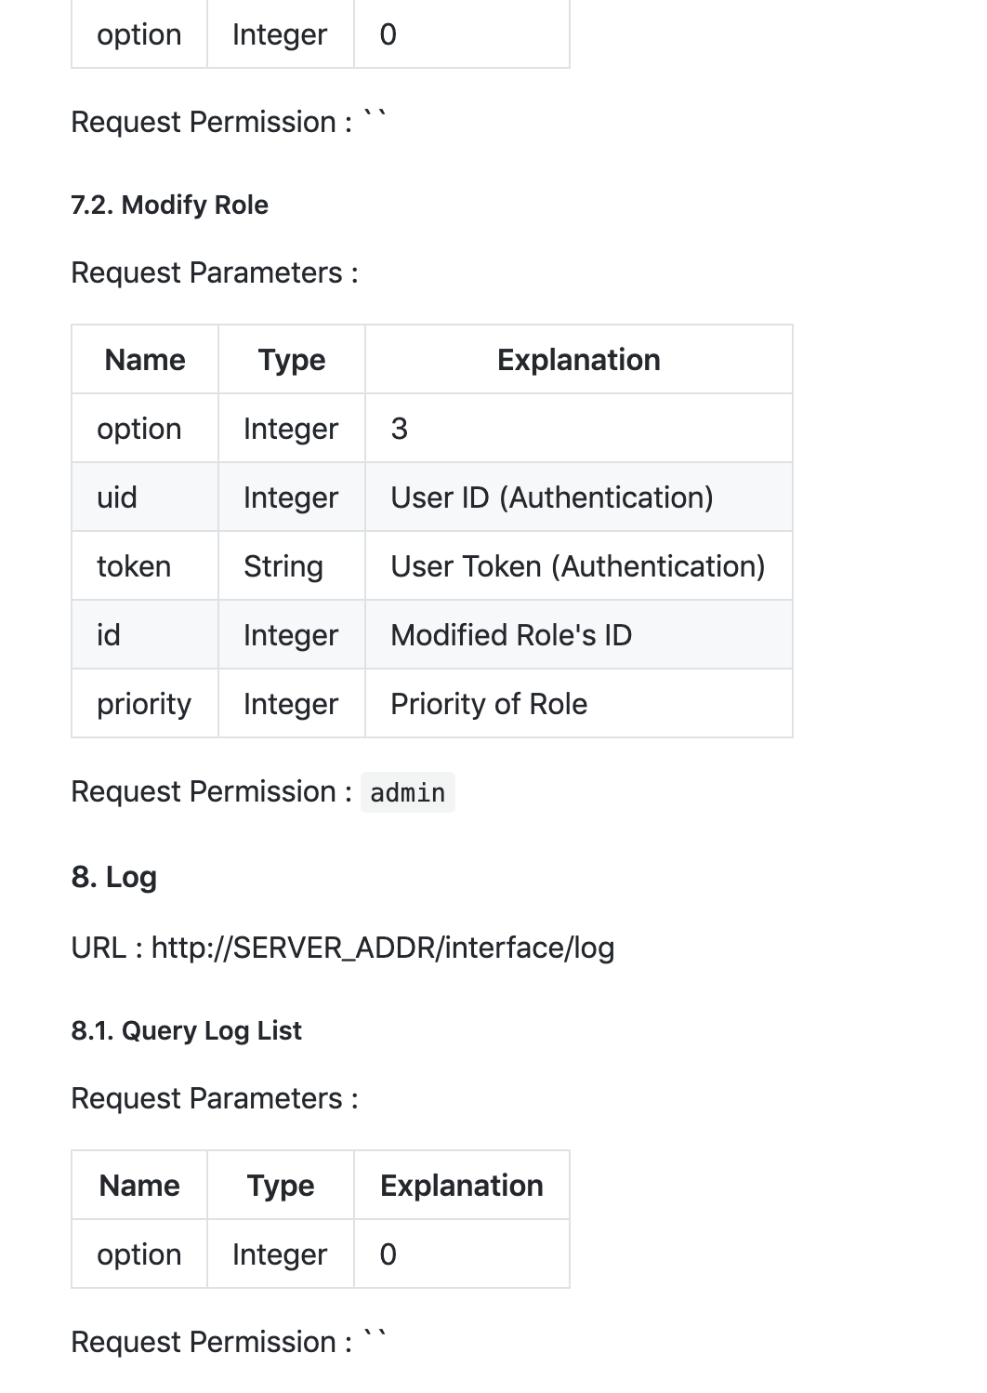
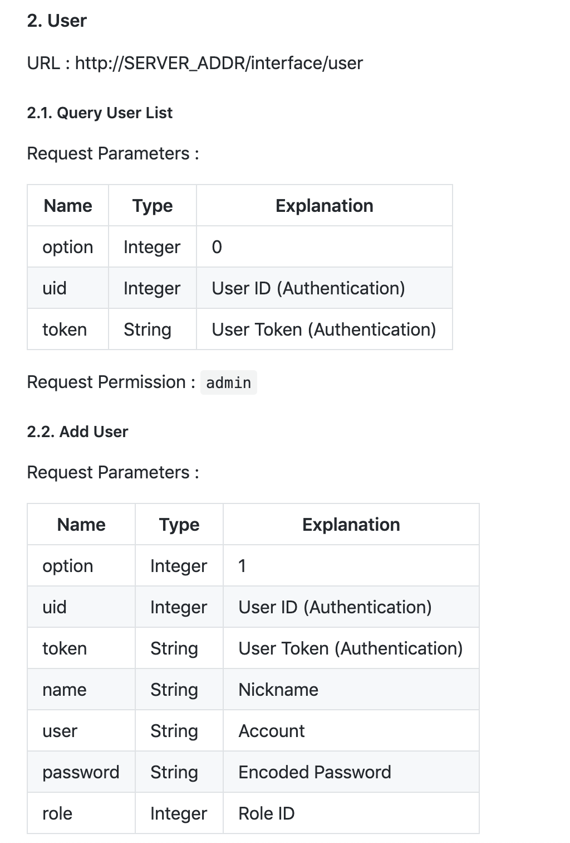
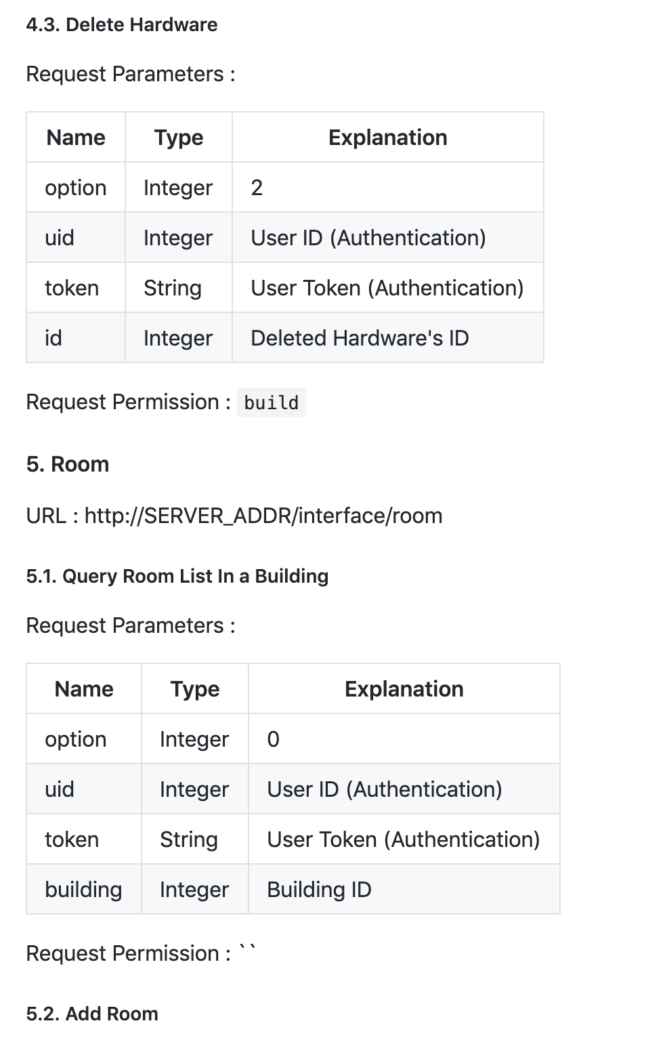
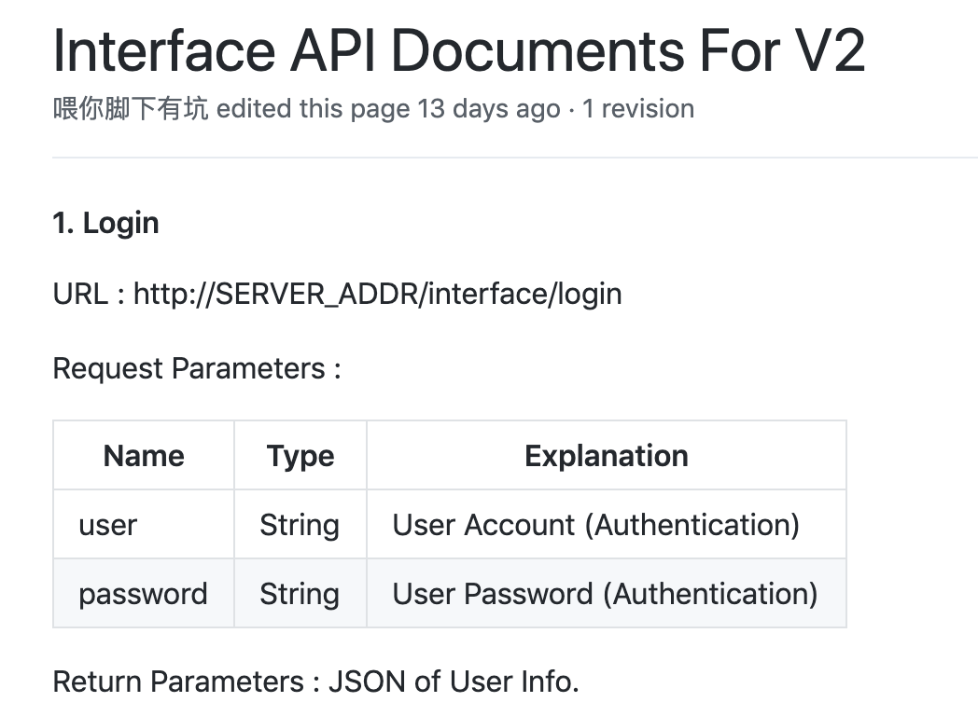
PART ONE Documents : Wiki

Slide 9
PART ONE Documents
SRS – Zimu Hu & Zhi Zhou
IS, SDS – Rexiang Zhu & Zhi Zhou
Interface Wiki – Zhi Zhou

Slide 10
GitHub & Code
PART TWO

Slide 11
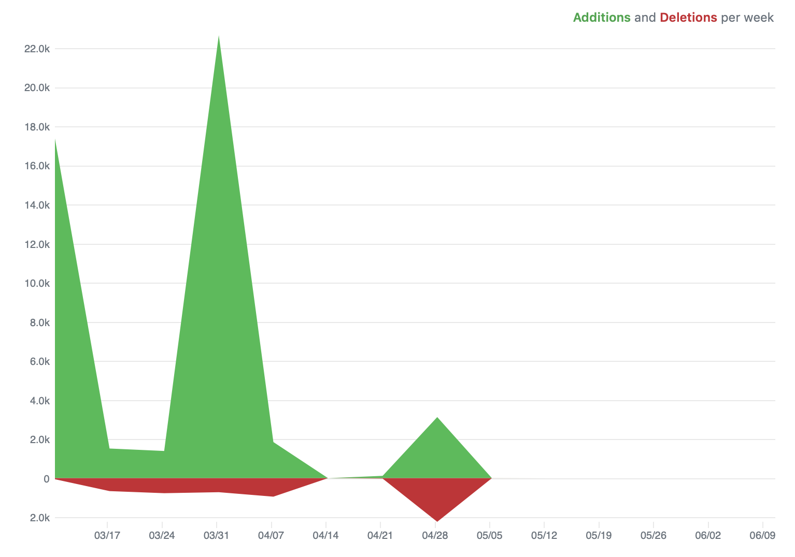
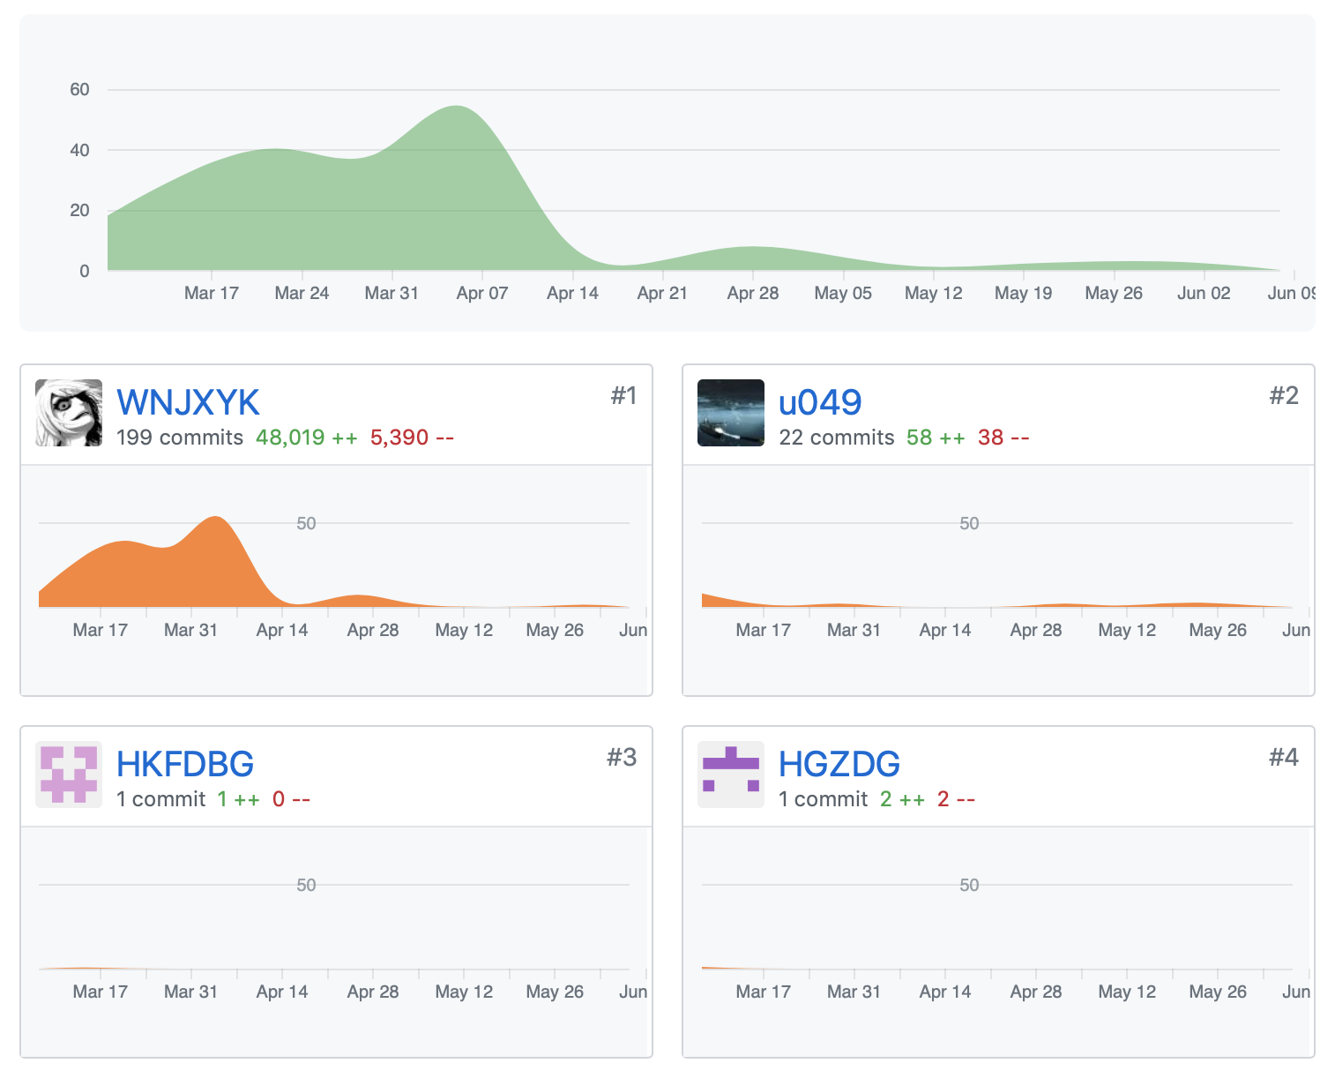
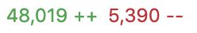
PART TWO GitHub & Code

Slide 12
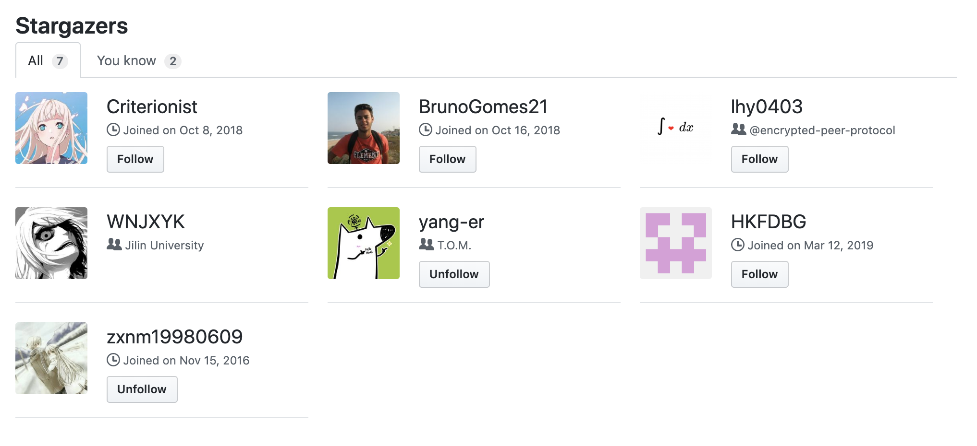
7 Stars

Slide 13
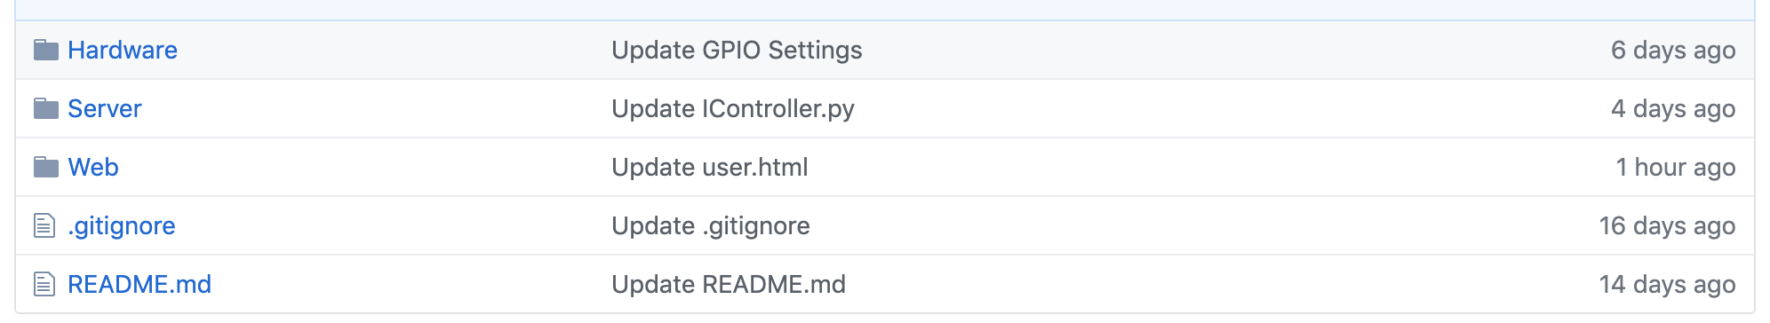
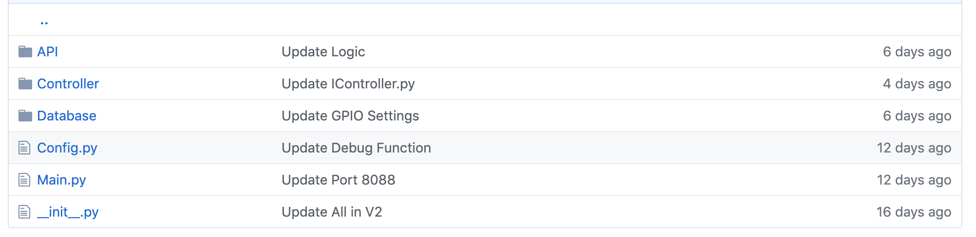
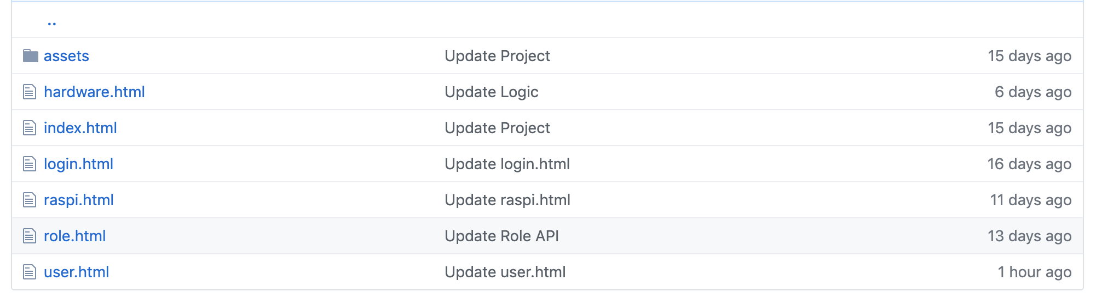
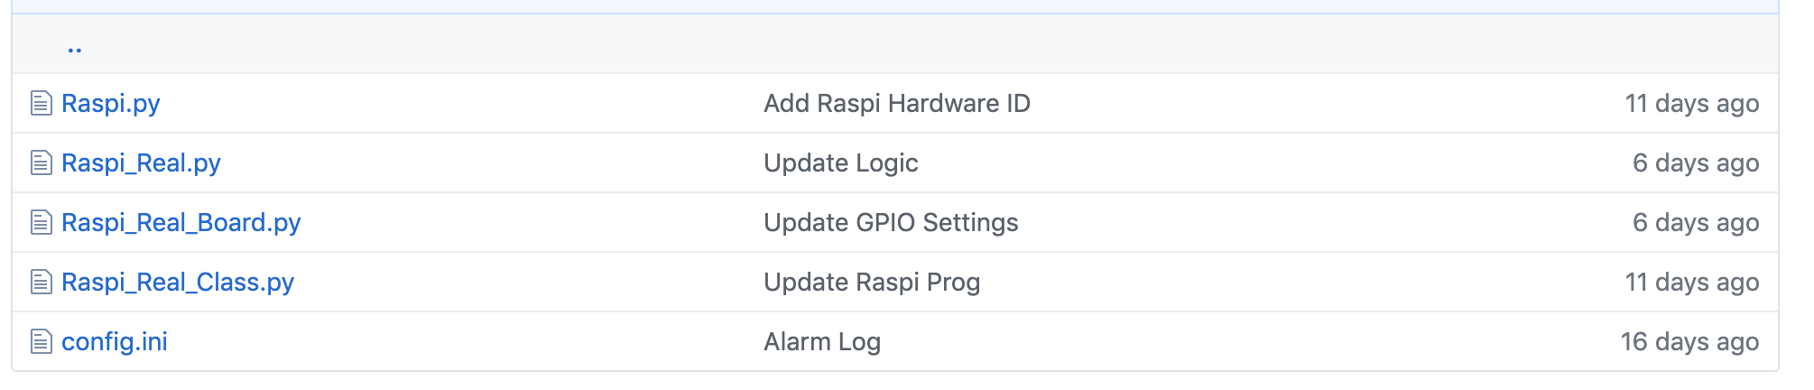
Project Structure (For V2)

Slide 14
PART TWO GitHub & Code
Server : Zhi Zhou
Alternative Module : Zhi Zhou
Database Interface : Dengtai Wang
Hardware : Jiahe Xu & Zhi Zhou

Slide 15
Productions
PART THREE

Slide 16
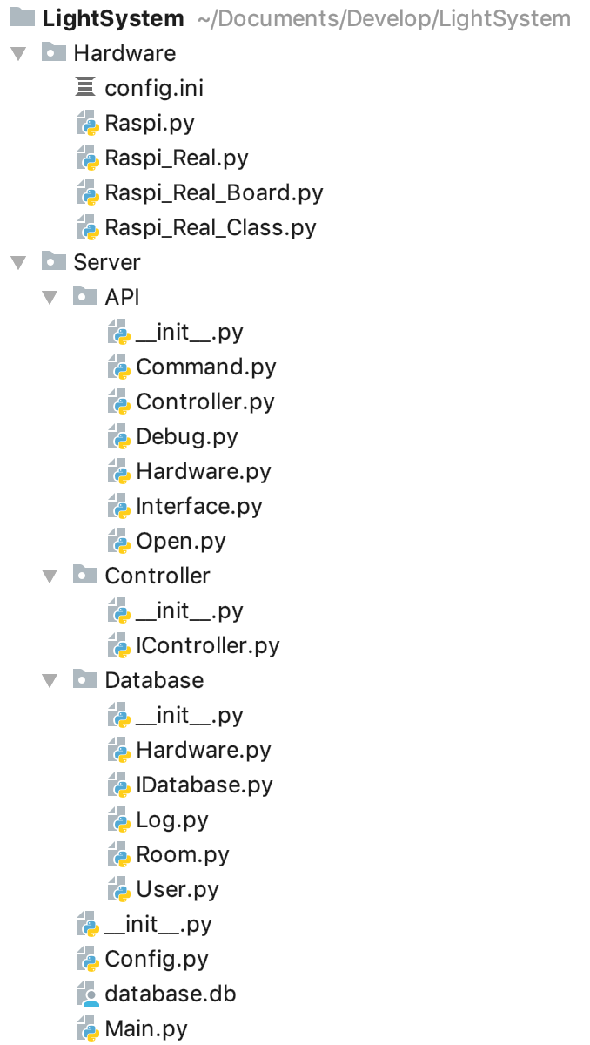
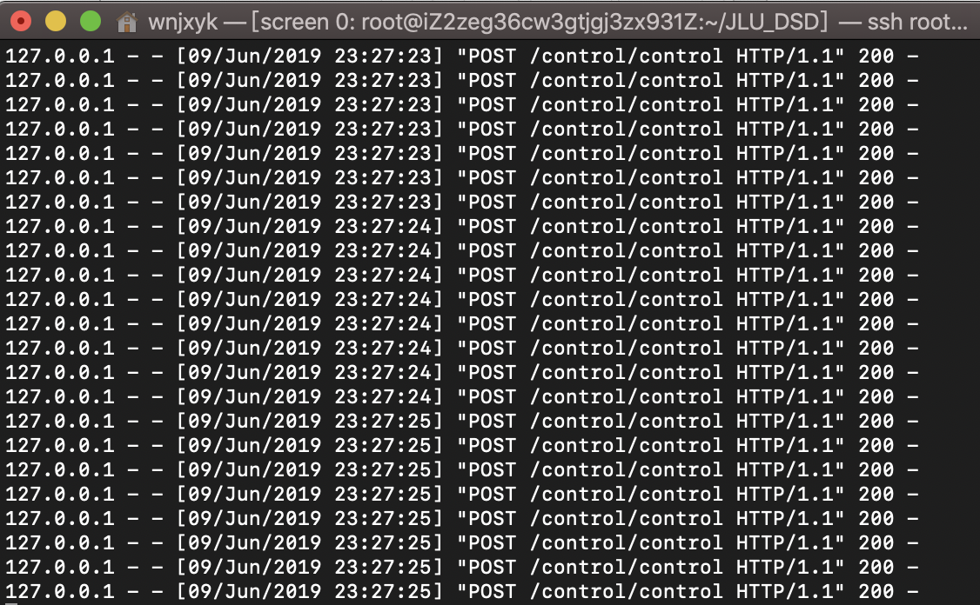
PART THREE Web
Server(Python)
Web Interface (Flask)
Building
Room
Raspberry PI
Sync(HTTP)
User
Role
Intelligence Controller
Generate Data Package
Hardware

Slide 17
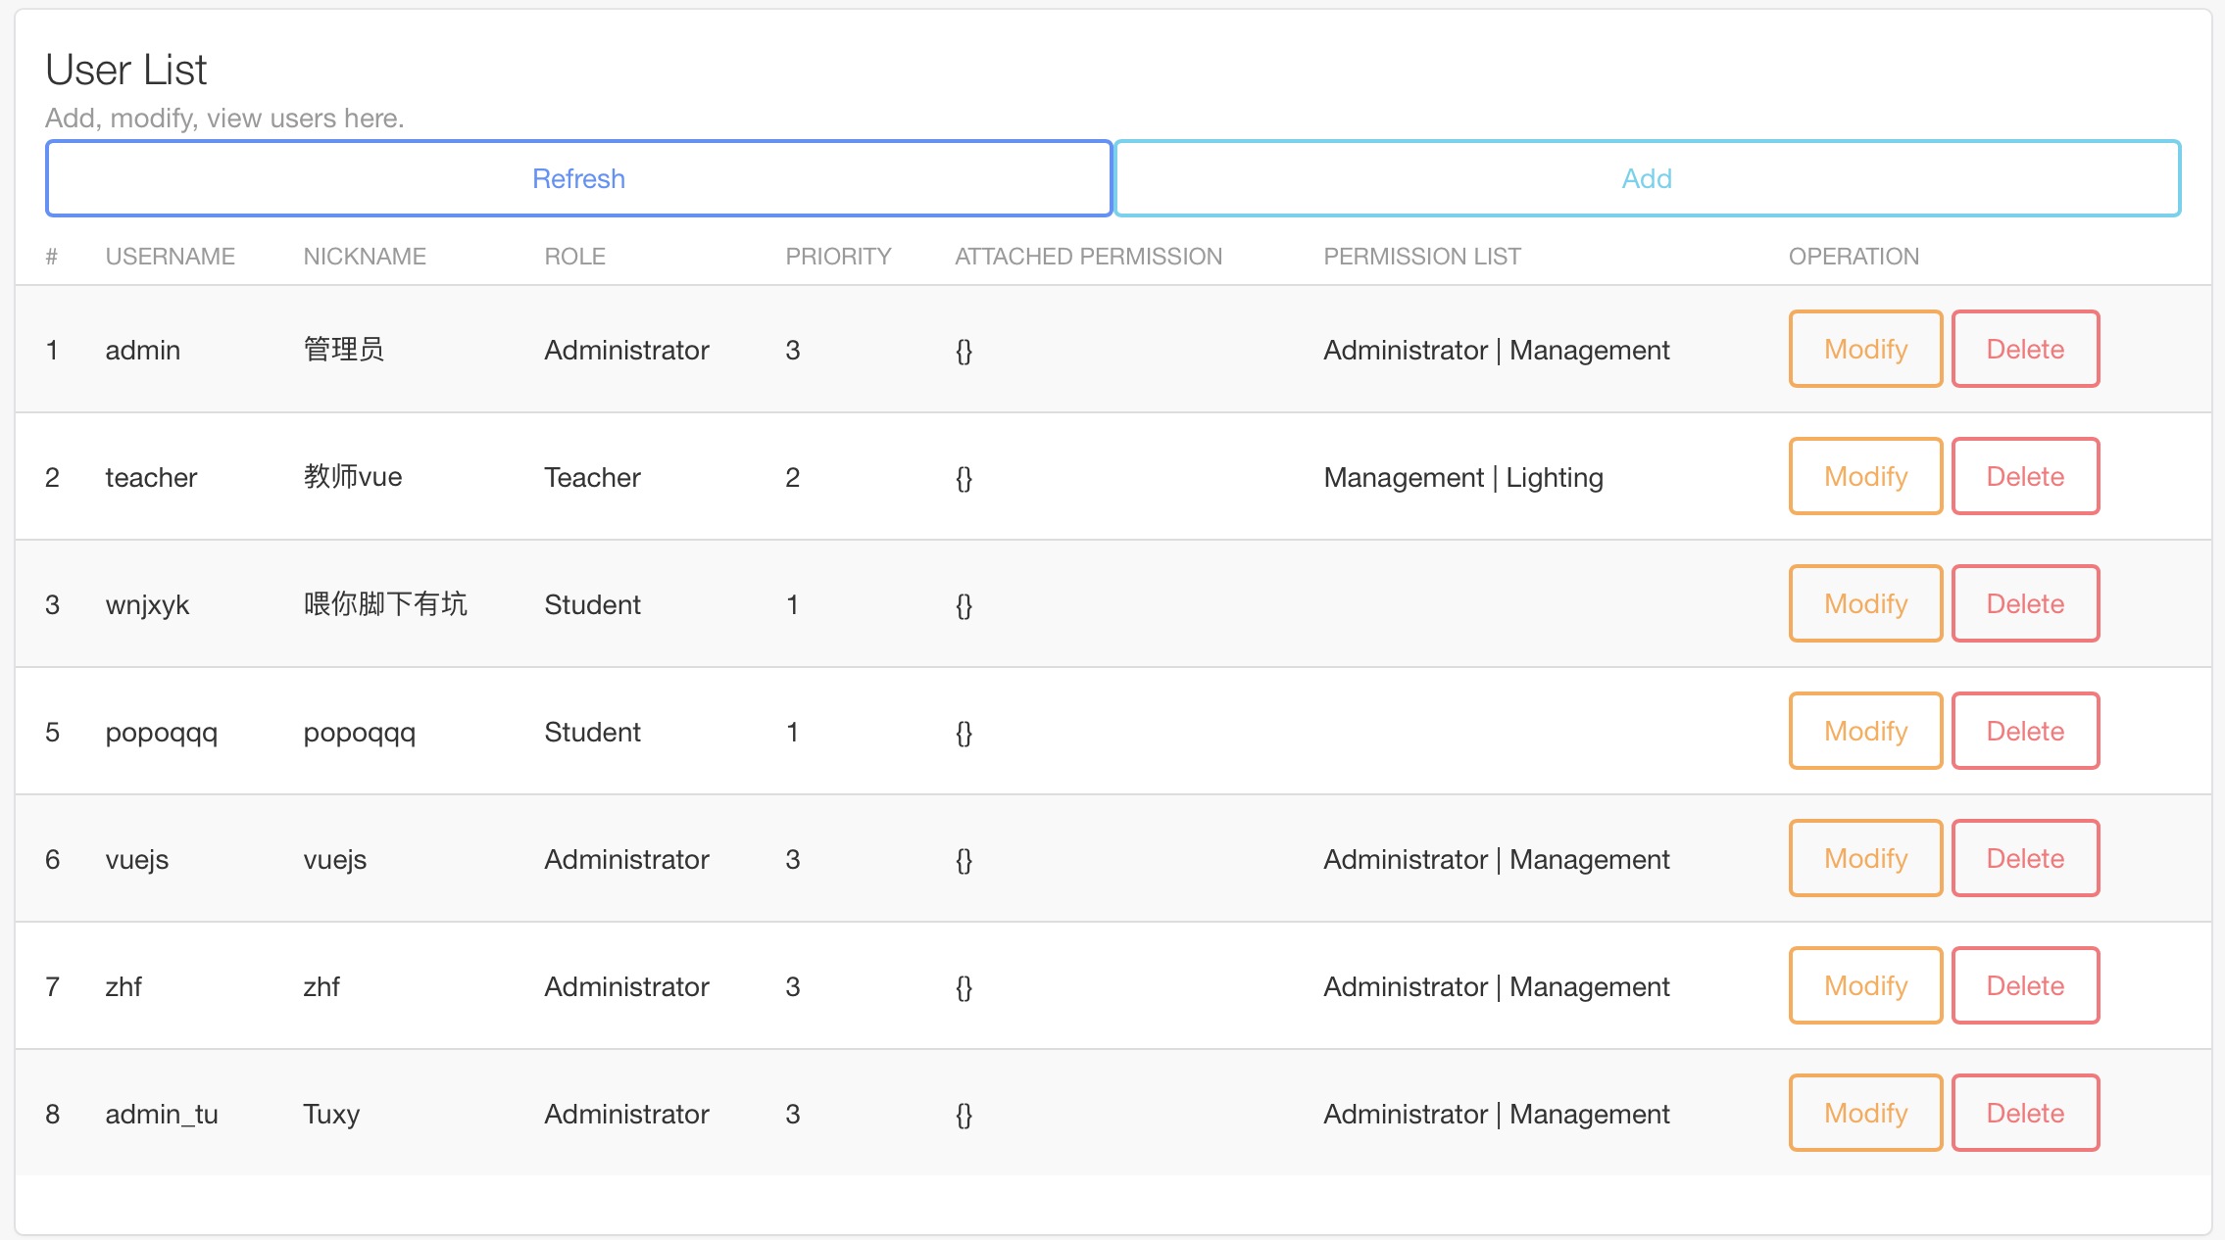
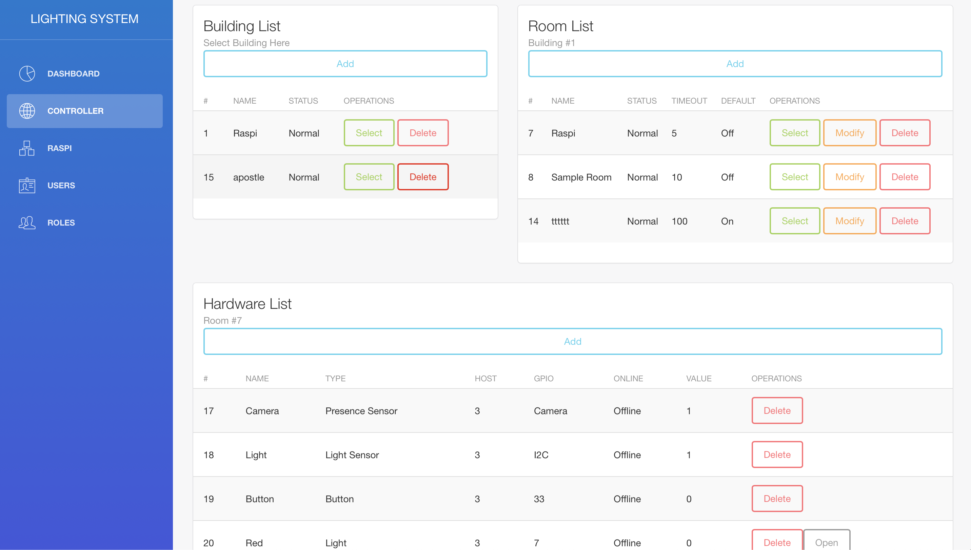
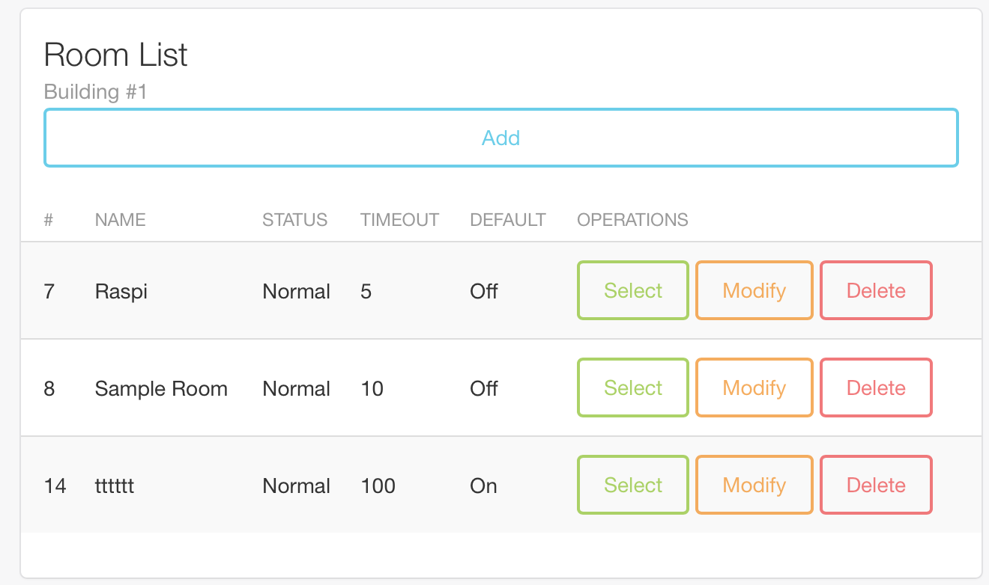
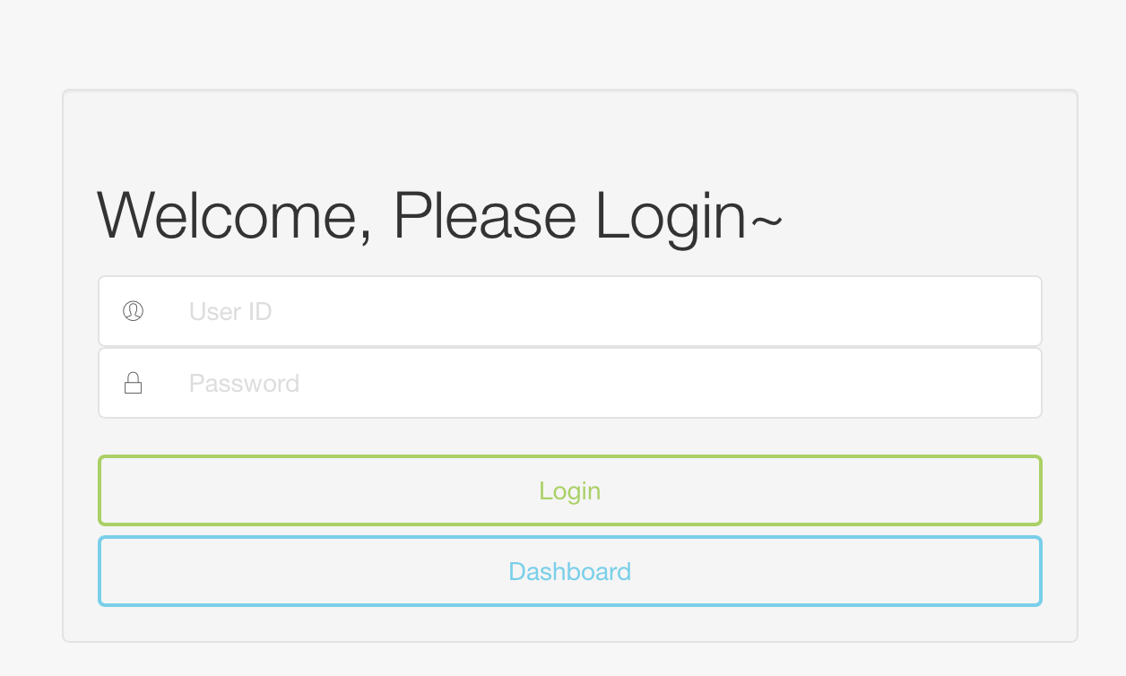
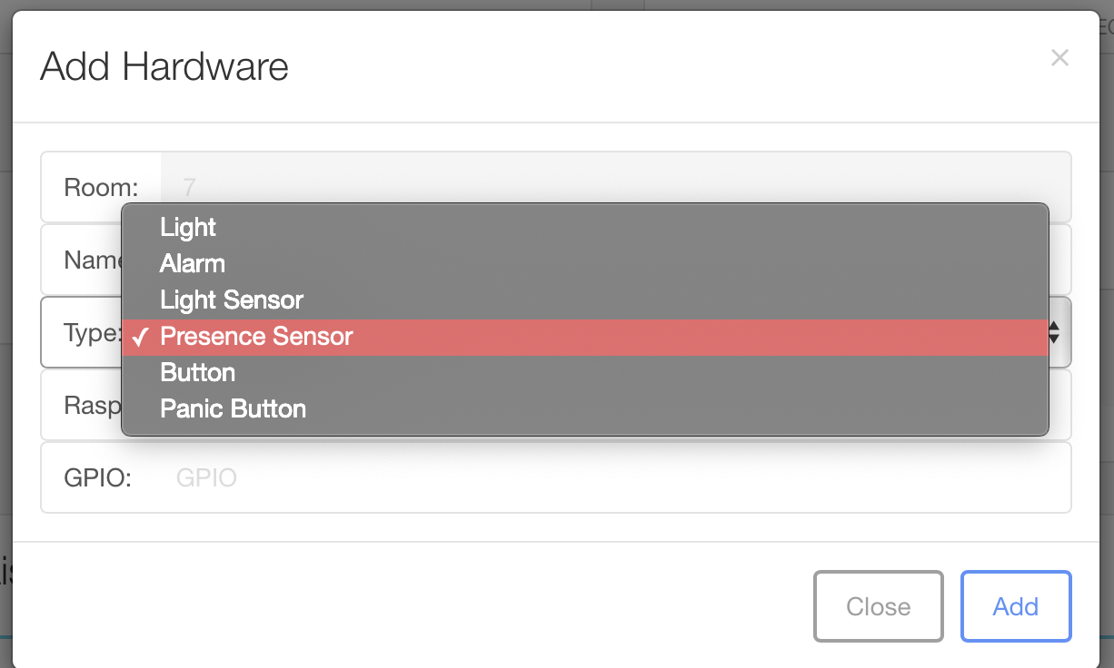
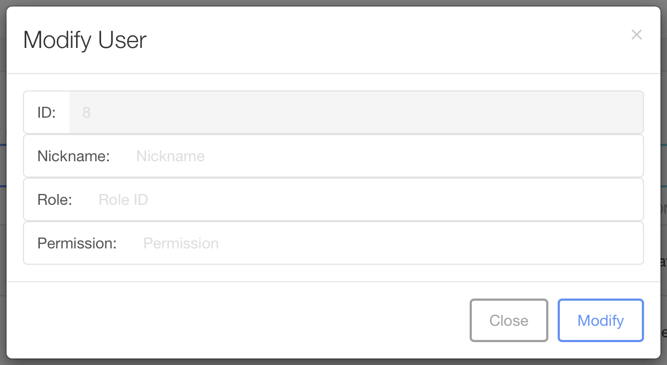
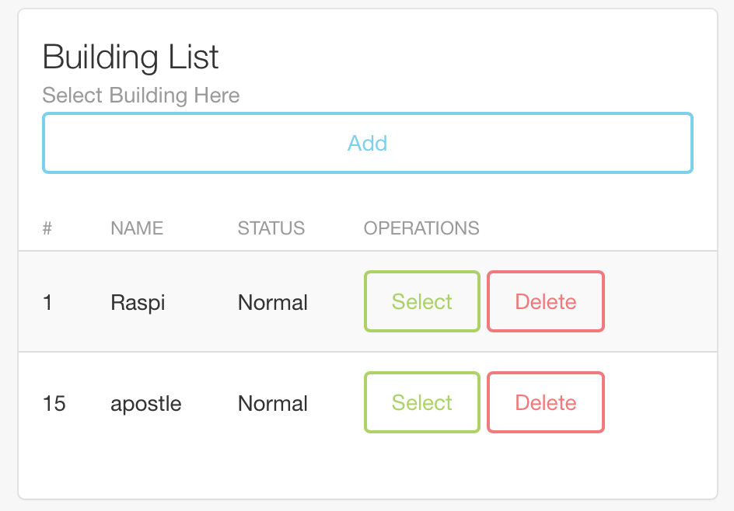
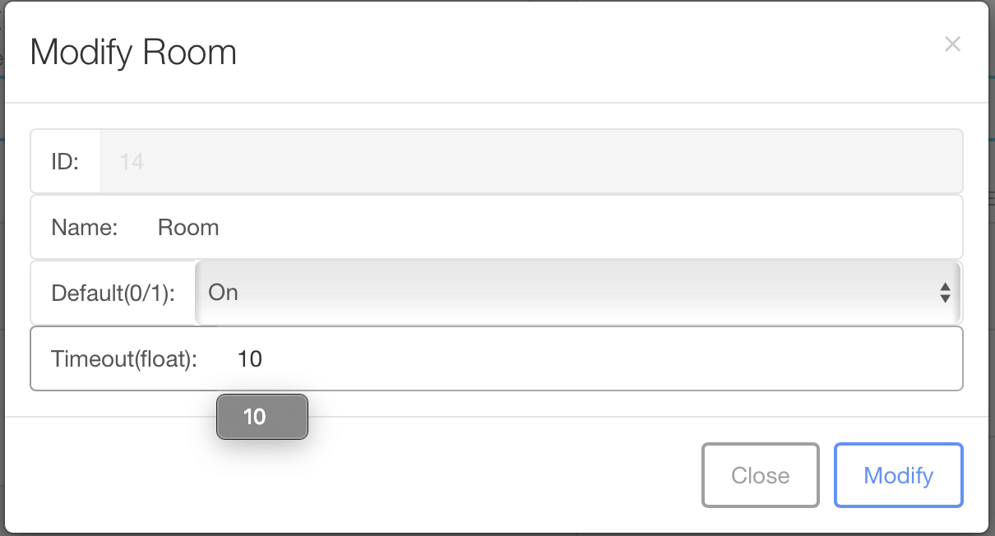
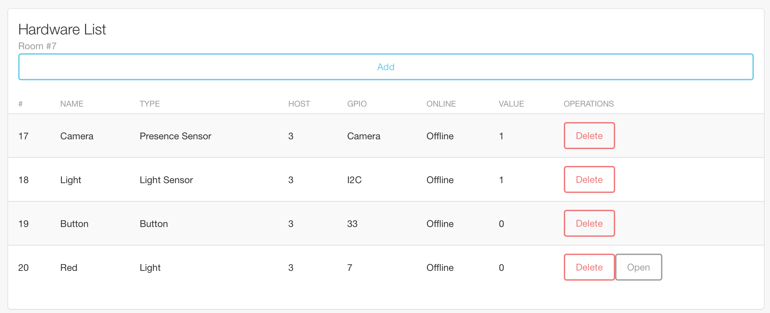
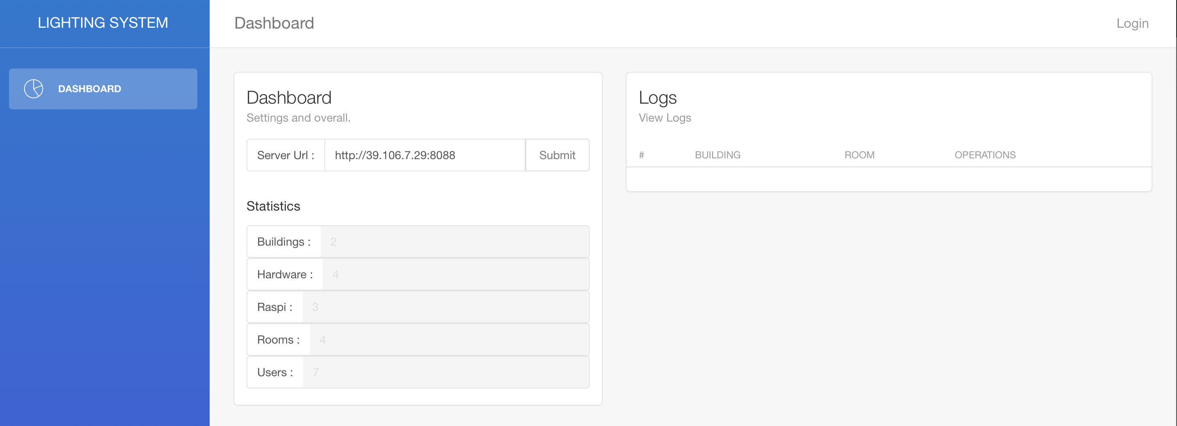
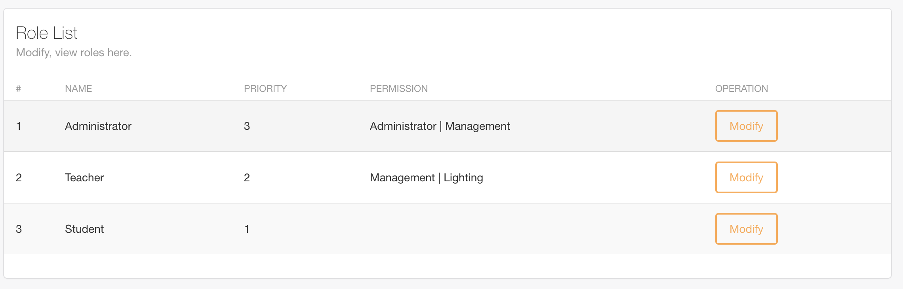
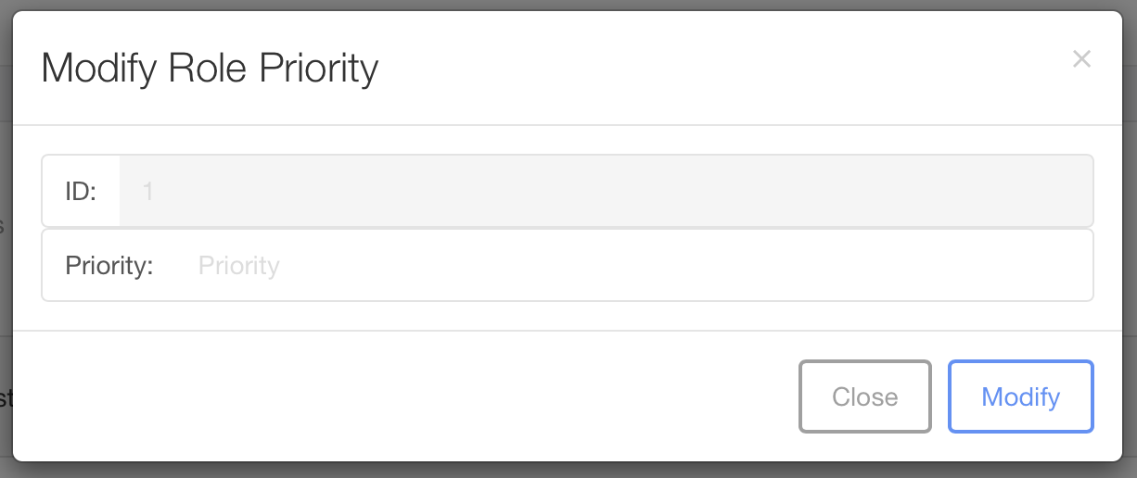
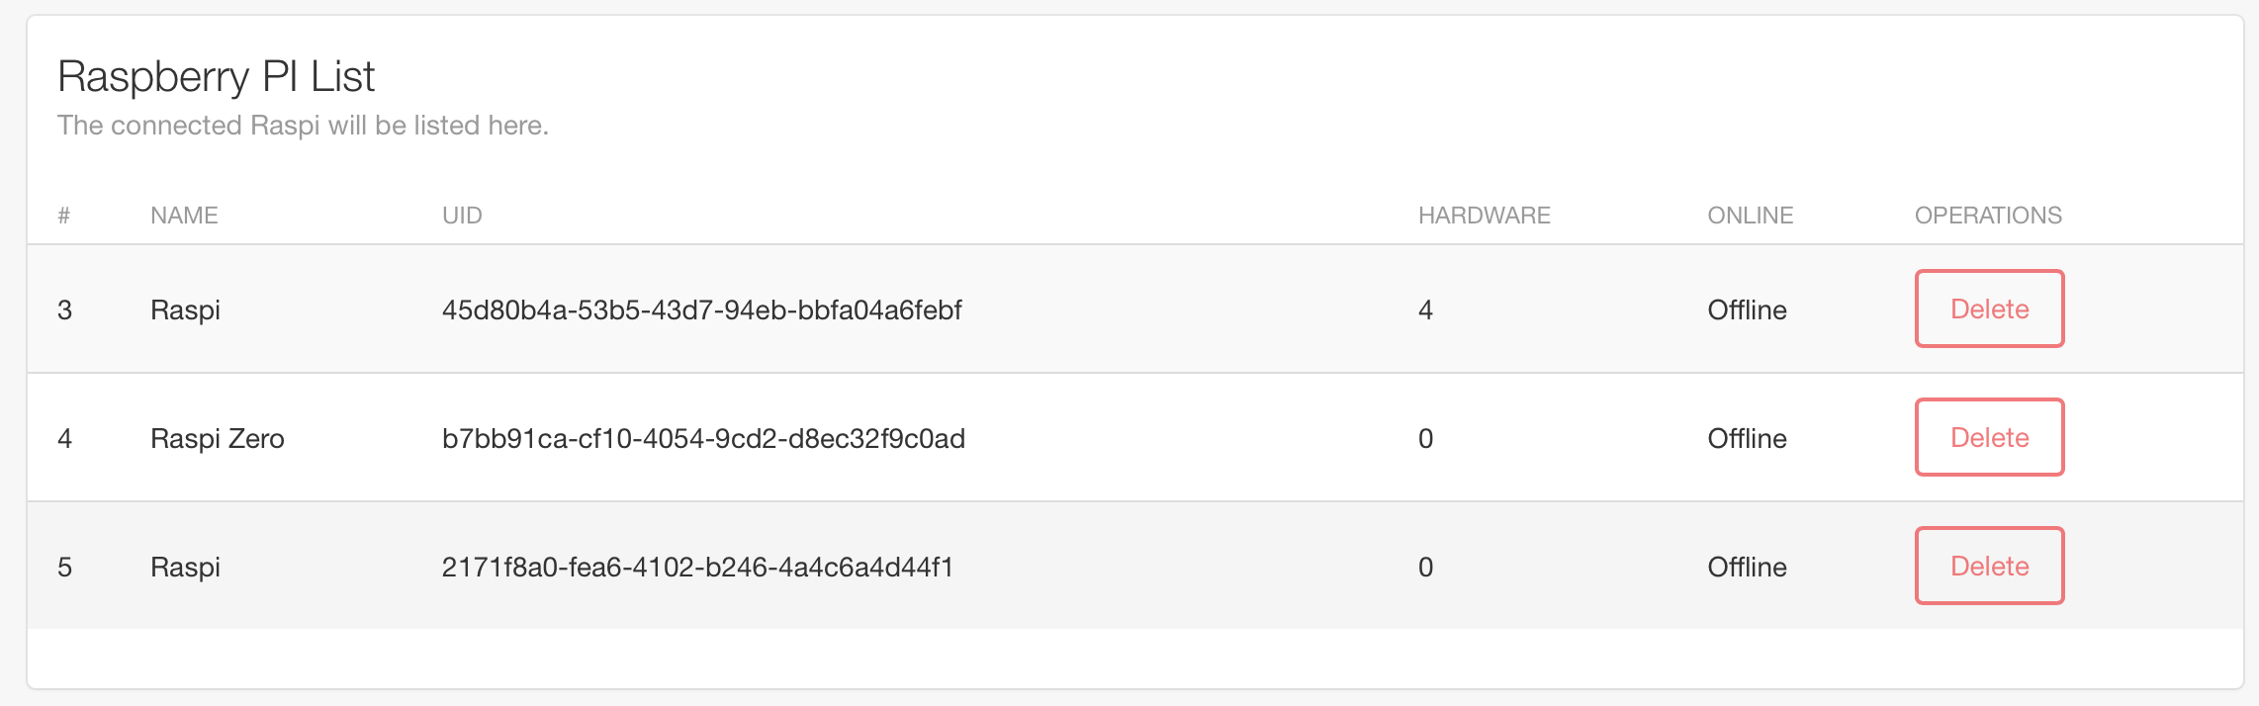
Alternative Module : Web （For Testing Server & Hardware）

Slide 18
Integration & Test
PART FOUR

Slide 19
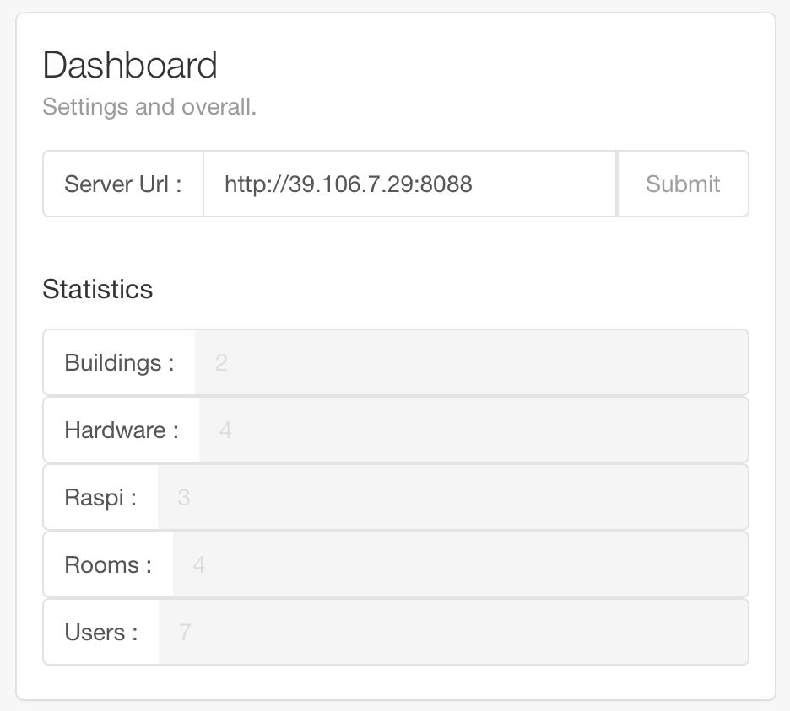
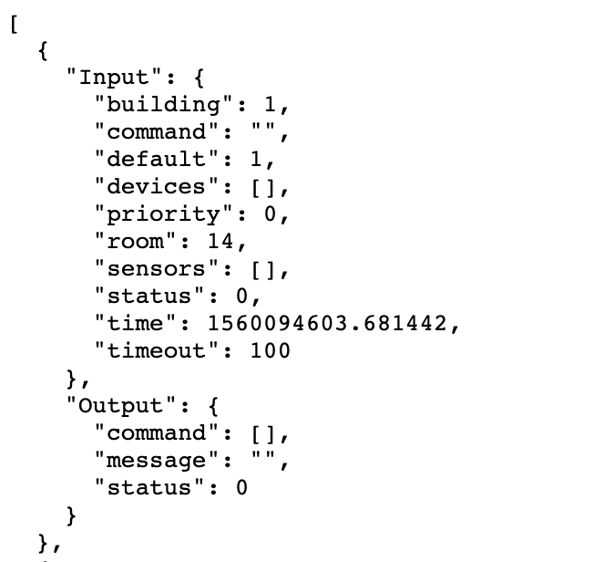
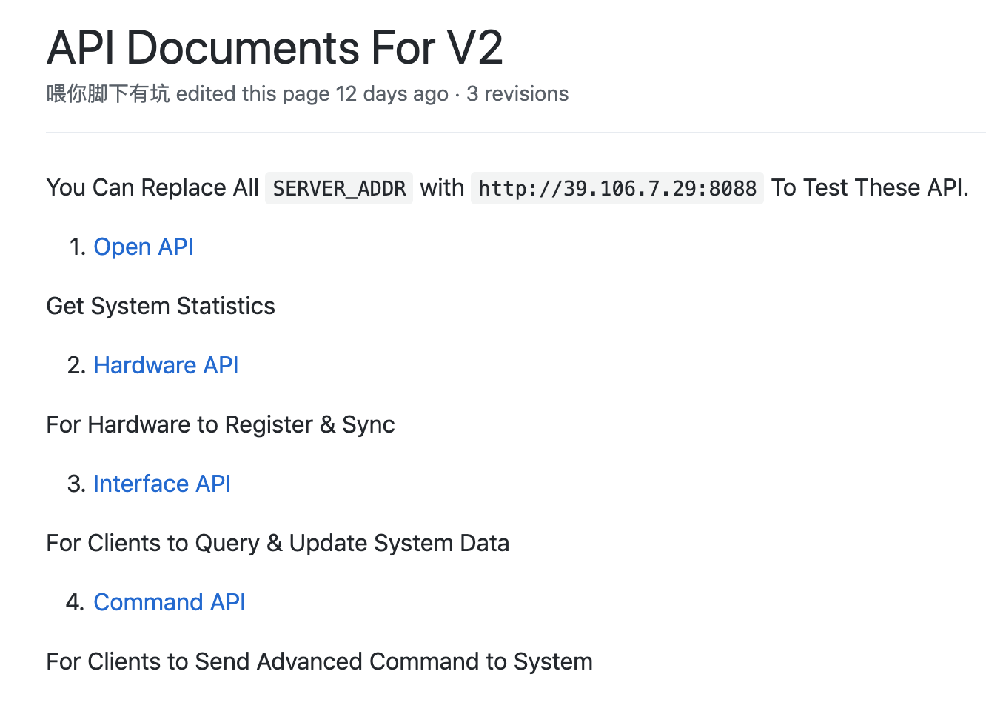
PART FOUR Integration & Test
Run Server On VPS
Debug Interface for IC
Interface Wiki
Run Server On VPS 24H A day.
Web And Android Group could test their functions while developing.
Open a Debug Interface for IC.
IC could get real-time data without all groups sitting at same place and doing integration.
Writing a Wiki for other groups.
They could find what they need when developing.

Slide 20
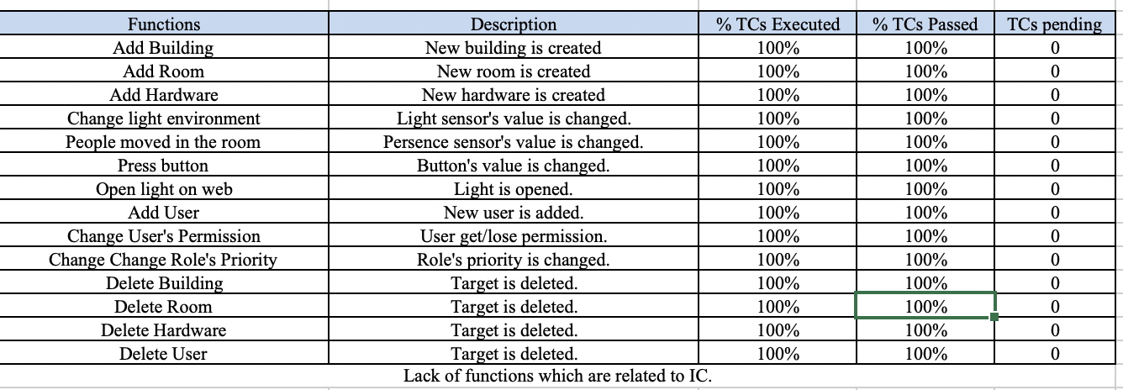
PART FOUR Test Reports

Slide 21
PART THREE Integration & Test
Hardware Test : Jiahe Xu
Server Function Test : Zhi Zhou & Haotian Xue & Bruno
Test Report : Zhi Zhou

